Slide 1
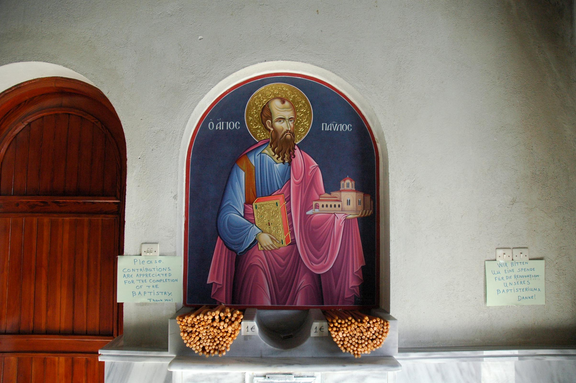
Image of Paul at the Baptistery of St. Lydia Chapel in Philippi ©2012 Todd Bolen / BiblePlaces.com

Slide 2
Philippians 1.12-14 NET: I want you to know, brothers and sisters, that my situation has actually turned out to advance the gospel: The whole imperial guard and everyone else knows that I am in prison for the sake of Christ, and most of the brothers and sisters, having confidence in the Lord because of my imprisonment, now more than ever dare to speak the word fearlessly.

Slide 3
Philippians 1.12-14 NET: I want you to know,
brothers and sisters, that my situation has actually turned out to advance the gospel: The whole imperial guard and everyone else knows that I am in prison for the sake of Christ, and most of the brothers and sisters, having confidence in the Lord because of my imprisonment, now more than ever dare to speak the word fearlessly.
ἀδελφοί = brothers; brothers and sisters;
or fellow members

Slide 4
Philippians 1.12-14 NET: I want you to know,
brothers and sisters, that my situation has actually turned out to advance the gospel: The whole imperial guard and everyone else knows that I am in prison for the sake of Christ, and most of the brothers and sisters, having confidence in the Lord because of my imprisonment, now more than ever dare to speak the word fearlessly.

Slide 5
Philippians 1.12-14 NET: I want you to know,
brothers and sisters, that my situation has actually turned out to advance the gospel: The whole imperial guard and everyone else knows that I am in prison for the sake of Christ, and most of the brothers and sisters, having confidence in the Lord because of my imprisonment, now more than ever dare to speak the word fearlessly.

Slide 6
Philippians 1.12-14 NET: I want you to know,
brothers and sisters, that my situation has actually turned out to advance the gospel: The whole imperial guard and everyone else knows that I am in prison for the sake of Christ, and most of the brothers and sisters, having confidence in the Lord because of my imprisonment, now more than ever dare to speak the word fearlessly.
μᾶλλον = “actually” here;
“more” in other contexts
προκοπή = advance
προσκοπή = hindrance

Slide 7
1-2: authors are slaves of Christ; readers are saints in Christ
3-8: authors thankful for past partnership of readers in the gospel mission, confident God will complete that work in them
9-11: authors pray the readers grow spiritually to discern what is of God [trusting this will result in continued partnership for the gospel mission]

Slide 8
Philippians 1.12-14 NET: I want you to know,
brothers and sisters, that my situation has actually turned out to advance the gospel: The whole imperial guard and everyone else knows that I am in prison for the sake of Christ, and most of the brothers and sisters, having confidence in the Lord because of my imprisonment, now more than ever dare to speak the word fearlessly.

Slide 9
Philippians 1.12-14 NET: I want you to know,
brothers and sisters, that my situation has actually turned out to advance the gospel: The whole imperial guard and everyone else knows that I am in prison for the sake of Christ, and most of the brothers and sisters, having confidence in the Lord because of my imprisonment, now more than ever dare to speak the word fearlessly.
because publically defended the gospel
because would not forsake defending the gospel
because God wanted him there to share the gospel
because this is discipleship “in Christ”

Slide 10
Bottom line, human reasoning vs.
Top line, divine revelation

Slide 11
Philippians 1.12-14 NET: I want you to know,
brothers and sisters, that my situation has actually turned out to advance the gospel: The whole imperial guard and everyone else knows that I am in prison for the sake of Christ, and most of the brothers and sisters, having confidence in the Lord because of my imprisonment, now more than ever dare to speak the word fearlessly.
the word = the gospel of Christ

Slide 12
Philippians 1.12-14 NET: I want you to know,
brothers and sisters, that my situation has actually turned out to advance the gospel: The whole imperial guard and everyone else knows that I am in prison for the sake of Christ, and most of the brothers and sisters, having confidence in the Lord because of my imprisonment, now more than ever dare to speak the word fearlessly.
τολμάω = dare;
to show boldness or resolution
in the face of danger, opposition, or a problem

Slide 13
Philippians 1.14-18a NET: … most of the brothers and sisters, having confidence in the Lord because of my imprisonment, now more than ever dare to speak the word fearlessly. Some, to be sure, are preaching Christ from envy and rivalry, but others from goodwill. The latter do so from love because they know that I am placed here for the defense of the gospel. The former proclaim Christ from selfish ambition, not sincerely, because they think they can cause trouble for me in my imprisonment. What is the result? Only that in every way, whether in pretense or in truth, Christ is being proclaimed, and in this I rejoice.

Slide 14
Philippians 1.14-18a NET: … most of the brothers and sisters, having confidence in the Lord because of my imprisonment, now more than ever dare to speak the word fearlessly. Some, to be sure, are preaching Christ from envy and rivalry, but others from goodwill. The latter do so from love because they know that I am placed here for the defense of the gospel…
κεῖμαι = “set” or “appointed” in this context

Slide 15
Philippians 1.14-18a NET: … most of the brothers and sisters, having confidence in the Lord because of my imprisonment, now more than ever dare to speak the word fearlessly. Some, to be sure, are preaching Christ from envy and rivalry, but others from goodwill. The latter do so from love because they know that I am placed here for the defense of the gospel. The former proclaim Christ from selfish ambition, not sincerely, because they think they can cause trouble for me in my imprisonment. What is the result? Only that in every way, whether in pretense or in truth, Christ is being proclaimed, and in this I rejoice.

Slide 16
Philippians 1.14-18a NET: … most of the brothers and sisters, having confidence in the Lord because of my imprisonment, now more than ever dare to speak the word fearlessly. Some, to be sure, are preaching Christ from envy and rivalry, but others from goodwill. The latter do so from love because they know that I am placed here for the defense of the gospel. The former proclaim Christ from selfish ambition, not sincerely, because they think they can cause trouble for me in my imprisonment. What is the result? Only that in every way, whether in pretense or in truth, Christ is being proclaimed, and in this I rejoice.

Slide 17
Philippians 1.14-18a NET: … most of the brothers and sisters, having confidence in the Lord because of my imprisonment, now more than ever dare to speak the word fearlessly. Some, to be sure, are preaching Christ from envy and rivalry, but others from goodwill. The latter do so from love because they know that I am placed here for the defense of the gospel. The former proclaim Christ from selfish ambition, not sincerely, because they think they can cause trouble for me in my imprisonment...
οἴομαι = think, suppose, expect

Slide 18
Philippians 1.14-18a NET: … most of the brothers and sisters, having confidence in the Lord because of my imprisonment, now more than ever dare to speak the word fearlessly. Some, to be sure, are preaching Christ from envy and rivalry, but others from goodwill. The latter do so from love because they know that I am placed here for the defense of the gospel. The former proclaim Christ from selfish ambition, not sincerely, because they think they can cause trouble for me in my imprisonment. What is the result? Only that in every way, whether in pretense or in truth, Christ is being proclaimed, and in this I rejoice.
Τί γάρ; = What does it matter?

Slide 19
Philippians 1.12-18a
Image of Paul at the Baptistery of St. Lydia Chapel in Philippi ©2012 Todd Bolen / BiblePlaces.com

